Slide 6
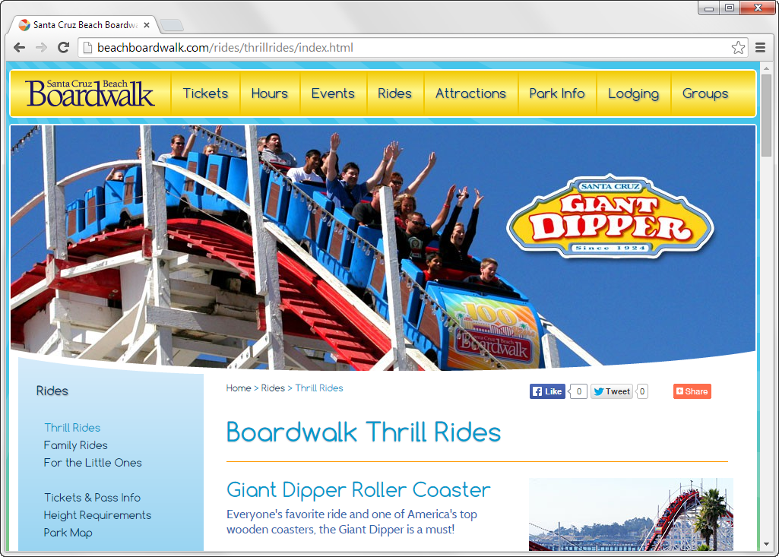

Slide 8
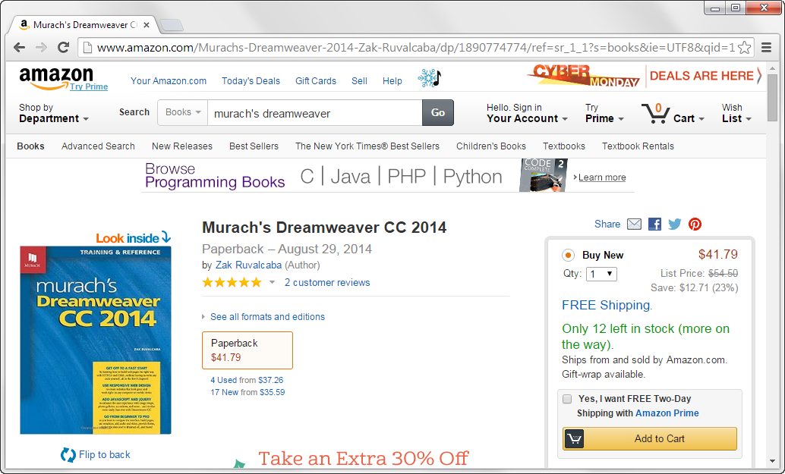

Slide 11
JSP and PHP run on an Apache web server (free)
ASP.NET runs on Microsoft’s Internet Information Services (IIS) which is not open-source and runs on a Windows system.

Slide 12
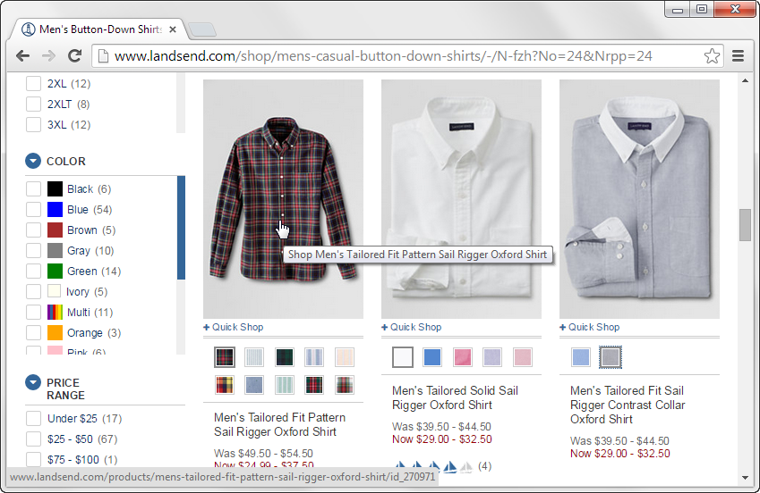
JavaScript is a scripting language used to do image swaps and rollovers.

Slide 14
Notes:
Page 478

Slide 15
Head contains elements that provide information about the document.
Body contains elements that will be displayed in the web browser.
Notes:
Elements can contain attributes that identify the element and define the way the content in the element is displayed.

Slide 16
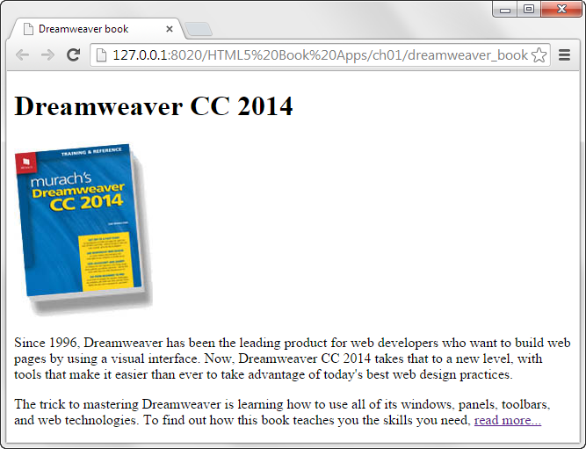

Slide 18
We learn CSS beginning in Chapter 4.
Notes:
Long ago, the HTML defined content and structure as well as formatting of the content. This is difficult to edit, maintain, and reformat.
Cascading Style Sheets (CSS) solves these problems using rule sets within declaration blocks. It does all the formatting and allows consistency to your web site.

Slide 19
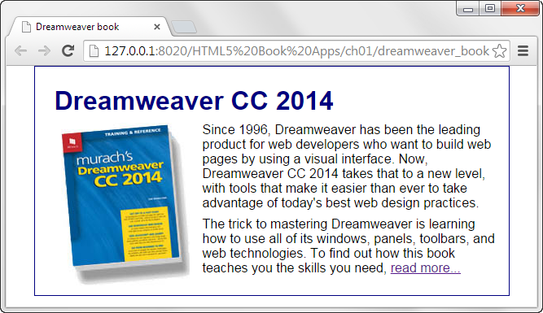

Slide 23
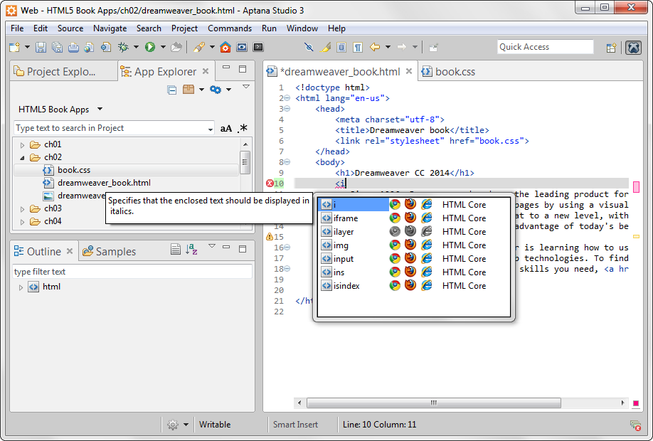

Slide 24
Text editors let you enter and edit HTML and CSS files
They highlight syntax and auto-complete
Aptana Studio 3 runs on Windows, Macintosh, and Linux.
I do not use Aptana but do use Notepad++.

Slide 26
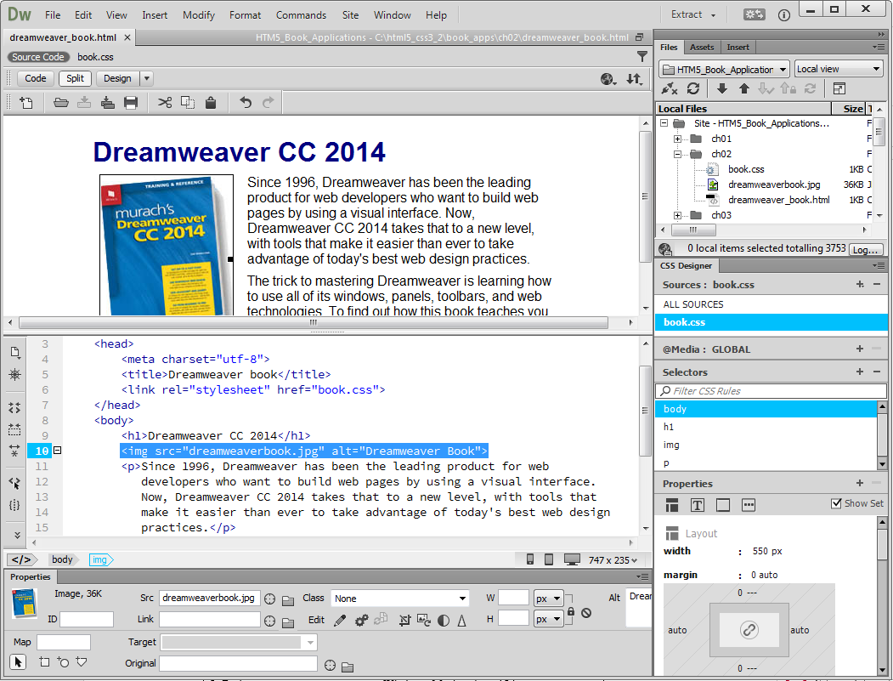

Slide 27
Used to deploy or publish a website on the Internet by transferring your folders and files to the web server hosting your web site.

Slide 28
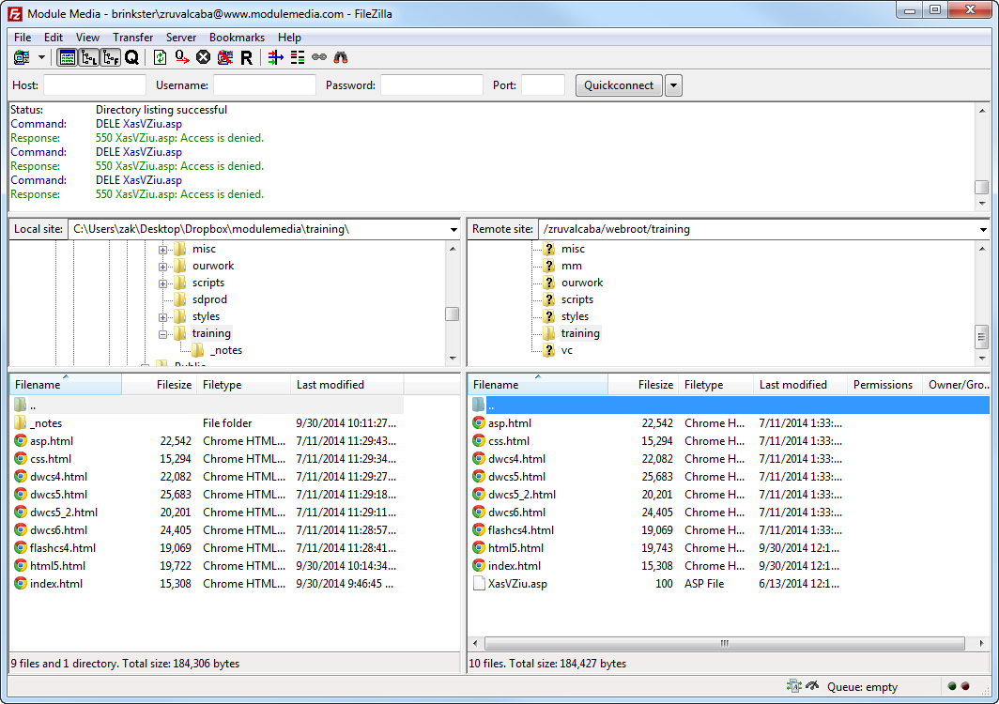

Slide 30
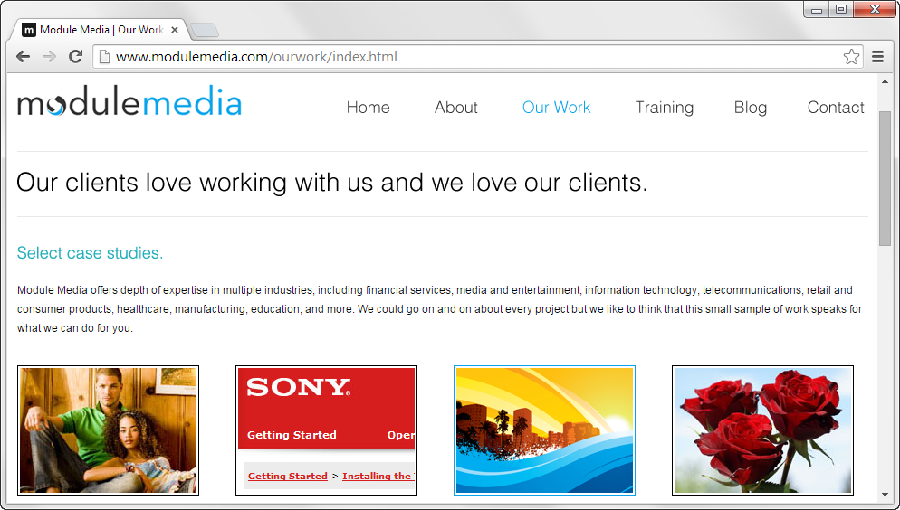

Slide 35
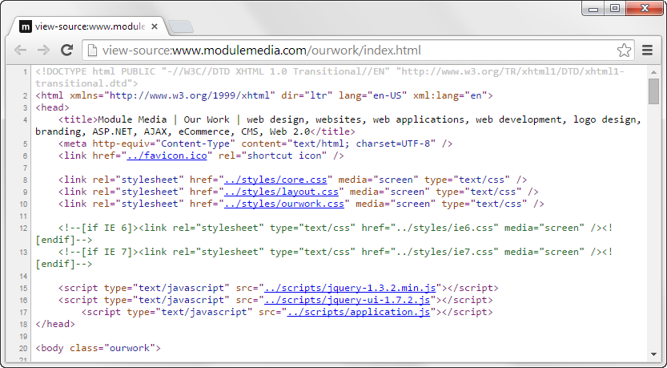

Slide 37
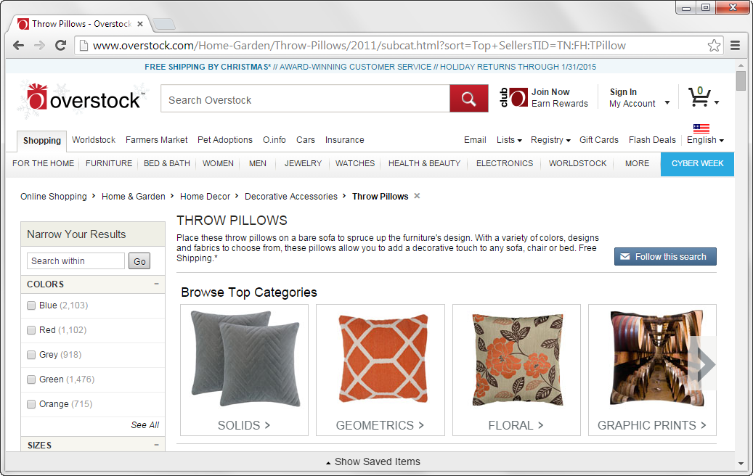

Slide 40
As of 2015

Slide 43
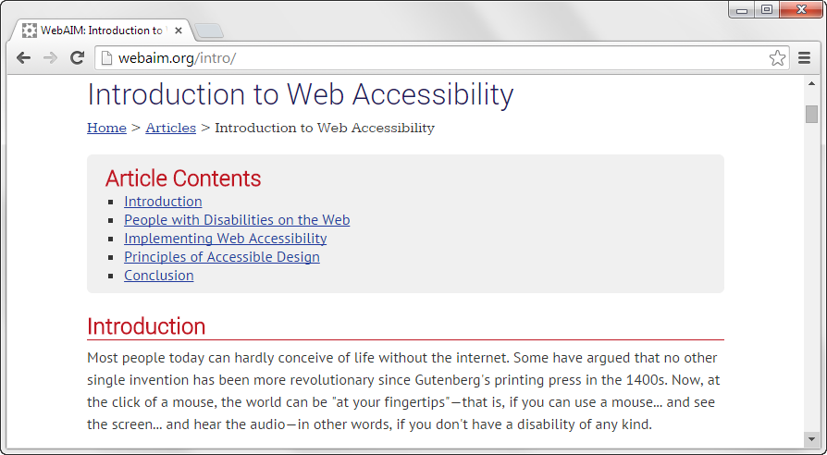

Slide 44
See pages 34 and 35

Slide 47
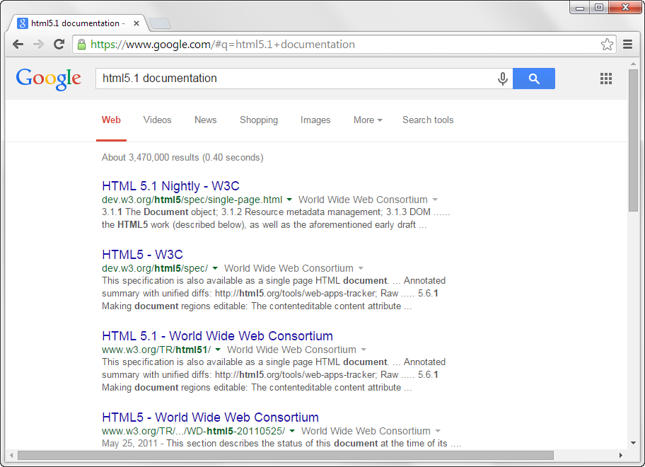

Slide 48
Search Engine Optimization (SEO) refers to the goal of optimizing your website so its pages will rank high in the search engines that are used to access them.

Slide 49
